Slide 1
Different types of readings
Rajan Arora
MCA, 1st sem

Slide 2
TOPICS WE WILL COVER
Why develop efficient reading?
Need for developing efficient reading skills.
Four factors of reading.
Type of reading – Active and Passive reading.
Reading skills.
Four basic type of reading skills.
Skimming c) Extensive reading
Intensive reading d) Scanning

Slide 3
WHY DEVELOP EFFICIENT READING ?

Slide 4
NEED FOR DEVELOPING EFFICIENT READING SKILLS
You definitely know how to read. But the question is whether you know how to read skillfully and artfully?
Have you ever noticed that we do not approach a novel, or a report, or a personal letter, or an email in a similar manner? In fact, the truth is that while reading, you employ different reading speeds and different approaches to them.

Slide 5
BENEFITS OF EFFECTIVE READING
Effective reading can provide you with a ‘comprehensible input’ from the book or document that you read.
It can enhance your general ability to use other language skills such as listening, speaking, and writing.
It can enhance your vocabulary, that is, you can always learn new words, phrases, and expressions.

Slide 6
Reading is concerned with four factors: decoding, comprehending, text analysis, and response
Decoding
The reader reads letters and focuses on them in order to change the coded message into information.
Comprehending
The reader interprets the message and understands its literal meaning.
Text Analysis Response
The reader critically examines and evalutes the message.
The reader responds to the messages.

Slide 7
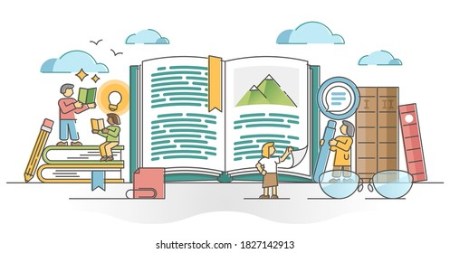
TYPES OF READING ACTIVE AND PASSIVE READING
You need to be an active reader rather than a passive one.
Active reading refers to a set of reading practices you may use to help understand the meaning of a written message.

Slide 8
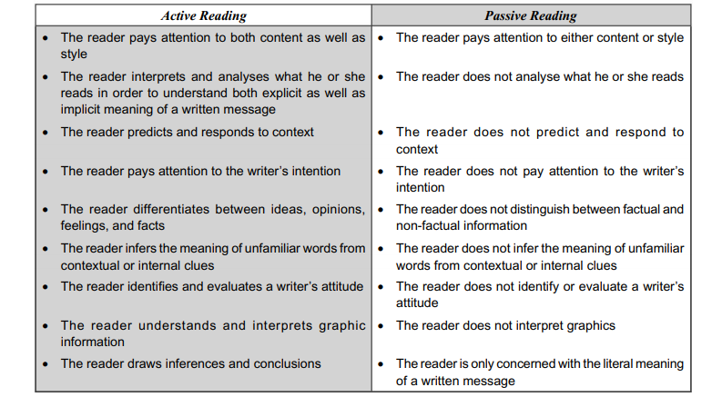

Slide 9
READING SKILLS
As a complex process of decoding and comprehending the written message, reading could be quite a challenging activity because the act of understanding is not always simple.
Rapid reading skills include prediction, scanning and skimming skills while intensive reading involves detailed reading, critical reading, and inferential skills.

Slide 10
FOUR BASIC TYPE OF READING SKILLS
1. SKIMMING
2. SCANNING
3. EXTENSIVE READING
4.INTENSIVE READING

Slide 11
SKIMMING
Skimming is used to quickly gather the most important information or ‘gist’ from the document or novel that you read. For this, you should make your eyes run over the text, noting important information. You may also go through the contents of the chapters rapidly, picking out and understanding the key words and concepts.

Slide 12
For example -–
While reading the newspaper in the morning, you quickly try to get the general news of the day and discover which articles you would like to read in more detail.

Slide 13
MORE EXAMPLES
The Newspaper – quickly to get the general news of the day
Magazines – quickly to discover which articles you would like to read in more detail.
Business and Travel Brochures – quickly to get informed

Slide 14
SCANNING
Scanning is used to find a particular piece of information. In this type of reading, you allow your eyes to run over the text, looking for the specific piece of information that you need.

Slide 15
For Example –
You use scanning when you go through your schedule or meeting plans, look for specific advertisements, or some specific information in a book, etc.

Slide 16
MORE EXAMPLES
A conference guide
A train/airplanes schedule
The “What’s on TV” section (itinerary) of your newspaper.

Slide 17
EXTENSIVE READING
Extensive reading is used to obtain a general understanding of a subject. It includes reading of the longer texts for pleasure.
In this type of reading, you should not worry if you do not understand each and every word. You can use this type of reading to improve your general knowledge of business procedures, or to know the latest marketing strategy.

Slide 18
EXAMPLES
The latest marketing strategy book.
A novel you read before going to bed.
Magazine article that interest you.

Slide 19
INTENSIVE READING
Intensive reading is used on shorter texts in order to extract detailed information. It includes very close and accurate reading for details.
You use this skill to grasp the details of a specific situation. In this case, it is important for you to understand each word, information, or fact.

Slide 20
INTENSIVE READING
When you read your text book for understanding the concepts or various theories, you have to read intensively. You also require to read every single detail when you want to go for an insurance claim or want to sign a contract.

Slide 21
EXAMPLES
A book keeping report.
An insurance claim.
A contract.

Slide 22
SUMMARY
Skimming
Reading rapidly for the main points.
Scanning
Reading rapidly through a text to find specific information required.
Extensive
Reading longer text, often for pleasure and for an overall understanding.
Intensive
Reading shorter text for detailed information with an emphasis precise understanding.

Slide 23
OUR PROCESS IS EASY
UNDERSTAND
IMPLEMENT
EVALUTE

Slide 24
THANK YOU!

